Slide 1
Central Auditory Processing Disorders

Slide 2
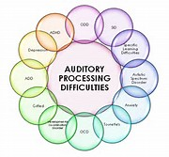
What is a Central Auditory Processing Disorder (CAPD)
CAPD is a disorder that affects the way the brain processes auditory information. Individuals with CAPD have normal hearing but they have trouble recognizing and interpreting auditory information.

Slide 3
Interesting Facts about CAPD
The number of children with CAPD is between 2-7%.
Boys are twice as likely as girls.
It is a rare disease as listed by the Office of Rare Diseases.

Slide 4
If you suspect CAPD
Preliminary testing is recommended to determine if language/learning deficits are impacting the student’s performance (ex. PPVT, Self, Language Processing Test, Differential Diagnosis).
Keep in mind ADHD, ADD, Anxiety, Autism, Depression, Learning Disabilities, OCD, SID, Tourette’s, and Gifted can be misinterpreted as Auditory Processing Disorder. Please evaluate these prior to requesting testing.
A Referral for Evaluation should be completed by team and sent to HILIA
CAPD case history to be completed by the school and parent(s).

Slide 5
CAPD Testing
Each complete evaluation is typically divided in to 2 sessions (2-3 hours each) due to patient fatigue/attention.
Session 1: Case History, Hearing evaluation, CAPD testing
Session 2: CAPD testing
Testing is normally done within a few weeks of referral based on availability
If student is found to have CAPD, a report will be sent to the school district and home to the family within 2 weeks. The report will include recommendations for environmental modifications, compensatory strategies and direct remediation.

Slide 6
Recommendations
Recommendations for students diagnosed with CAPD may include:
Environmental Modifications
Classroom seating, written AND oral instructions
Compensatory Strategies
Chunking information, pre-teaching, assignment management
Direct Remediation
Therapy at home/school, games/activities, computer-based programs

Slide 7
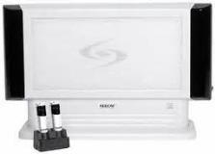
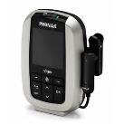
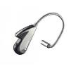
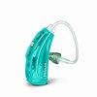
Equipment
Soundfields -
Personal FM – Isense, Focus, personal receivers.
This equipment is assigned based upon deficits identified during testing and not all children diagnosed with CAPD will require equipment.

Slide 8
Contact Information
Tami Scherer:
tdscher@ilstu.edu
309-438-1141
Dr. Alison Sherren:
asherre@ilstu.edu
309-438-1140
Statistics and pictures obtained from Speechbuddies.com, National Coalition of Auditory Processing Disorders and ASHA.org.

